Slide 1
EXPLAINABLE AI
PROJECT TEAM
Pranay Bunari BT16CSE014
G. Sathish Reddy BT16CSE024
G. Sai Karthik BT16CSE025
Eshwar Koride BT16CSE042
UNDER THE GUIDANCE OF
Dr. Dipti Shrimankar

Slide 2
Contents
Introduction
What is XAI?
Why XAI?
How
ML models explainability
What We Plan To Do

Slide 3

Introduction

Slide 4
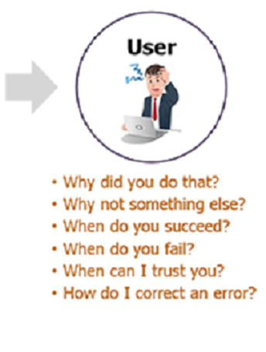
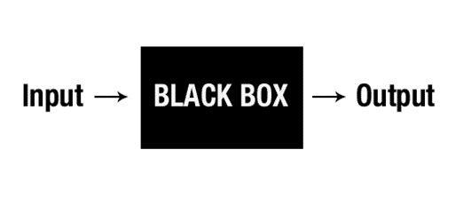
What is XAI?
AI can make decisions better but can it make better decisions?

Slide 5
What is XAI?
Explainable Artificial Intelligence(XAI) is an AI form which can be understood by humans.

Slide 6
WHY XAI?

Slide 7
WHY do we need Explainability ?
1)User view
2)Data Scientist view
How does Asthma helps pneumonia patients?
3)Regulators view
4)Executive approval

Slide 8
What’s a GOOD explanation
Explanations are contrastive
-”How would the prediction have looked like, if input X are different”.
Explanations are selected
Explanations are social, contextual
Explanations focus on the abnormal
Explanations are coherent with prior beliefs of the explainee
May be good explanations are truthful

Slide 9
HOW?
Industries possibly have moved using AI without thinking about how do we explain it.
Types of XAI
Global Interpretability Local Interpretability
- requires explaining the - Explaining a single
whole model for all the data instance and how a particular prediction was made

Slide 10
Different Approaches for XAI
1)Local perturbation like LIME
2) Counter Factual Explanations
3)Global Support based like FICO reason reporter
4)Interpretable Architecture

Slide 11
ML Models Explainability
Consider an example of AI Claim Management solution for insurers
We know that Claim Management involves many features such as Capital, Loan Type, Claim Type, Interest rate etc.
Now we see how the features are given weights for different models….

Slide 12
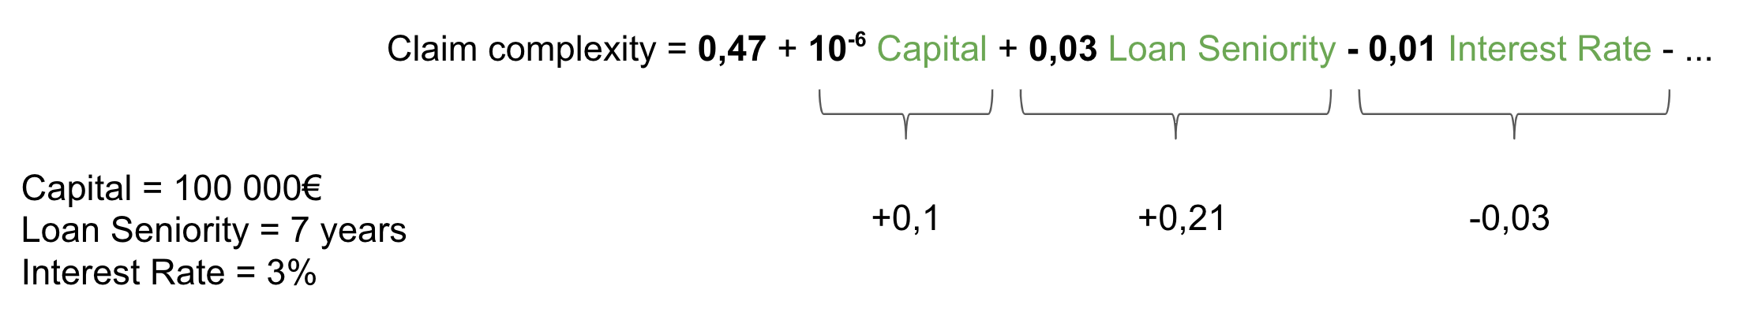
Linear Model Explainability
Linear Models Explainability is straightforward.
The prediction is the linear combination of the features values, weighted by the model coefficients.

Slide 13
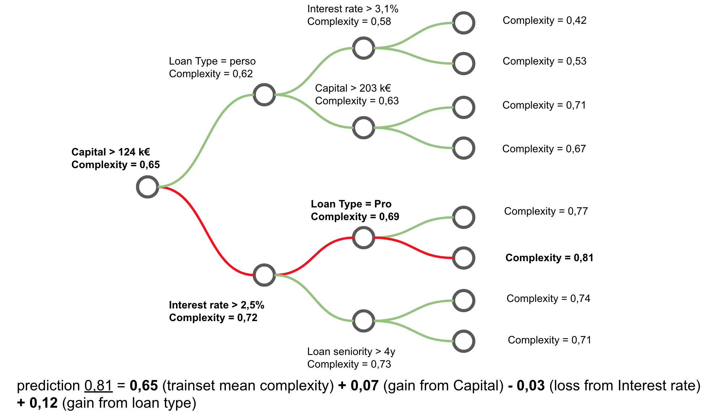
Random Forest Model Explainability
This approach tries to explain features contributions for each prediction individually.

Slide 14
What we plan to do
A Framework to support various types of ML models to inspect features that have contributed to the algorithm output
Steps :-
1.Figure out various ML algorithms like Linear Regression, Logistic Regression
Classification.
2.For each of these ways need to figure out the best way to intuitively
explain the model output to end customer of ML models.
3.Create a tool/ framework, input to which will be ML model and
output will be an UI explaining the output along with names, weights,
significance of each feature being considered for this decision.

Slide 15

Thank you!

Slide 16
EXPLAINABLE AI
PROJECT TEAM
Pranay Bunari BT16CSE014
G. Sathish Reddy BT16CSE024
G. Sai Karthik BT16CSE025
Eshwar Koride BT16CSE042
UNDER THE GUIDANCE OF
Dr. Dipti Shrimankar

Slide 17
Agenda
Introduction
SHAP(What, Why)
SHAP on Linear Regression
SHAP on Random Forest
SHAP on Logistic Regression
What are we going to do next?

Slide 18
Project timeline
AUG
SEP
OCT
Study and re-search
Project & Team Finalization
Background Work on applications.

Slide 19
SHAP(SHapley Additive exPlanations)
Additive Feature Attribution methods
SHAP and LIME are both popular Python libraries for model explainability
LIME is actually a subset of SHAP but lacks the some properties
SHAP assigns each feature an importance value for a particular prediction
SHAP values as a unified measure of feature importance
Shapley values consider all possible predictions for an instance using all possible combinations of inputs

Slide 20
SHAP on Linear Regression

Slide 21
Linear Regression
1.A model to predict house prices
2.A dataset which consists of information about the location of house,
Price and other aspects such as square feet, number of bedrooms etc.
3.We use linear regression for this dataset
4.Integrating SHAP to this model

Slide 22
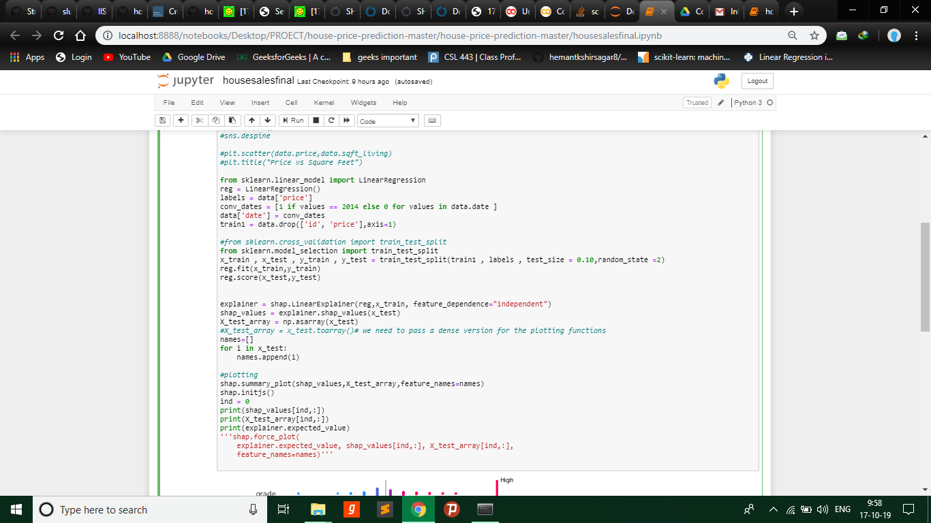

Slide 23
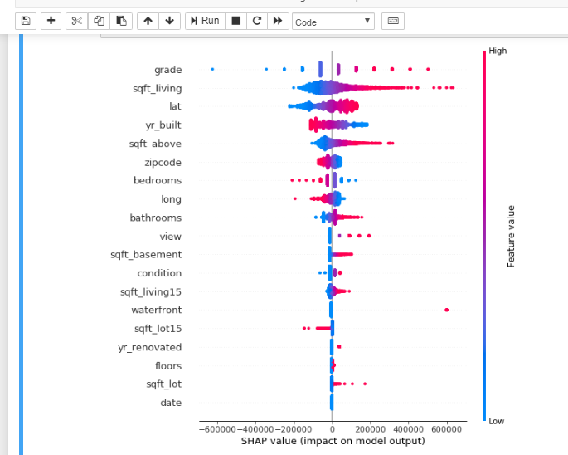

Slide 24
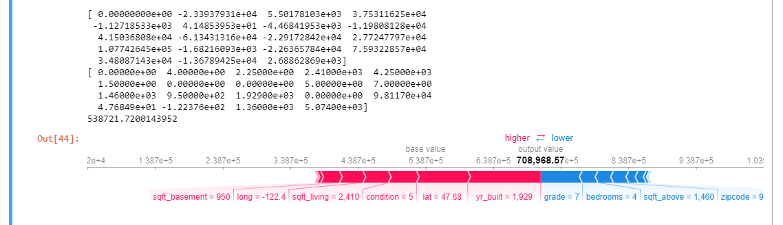
Output

Slide 25
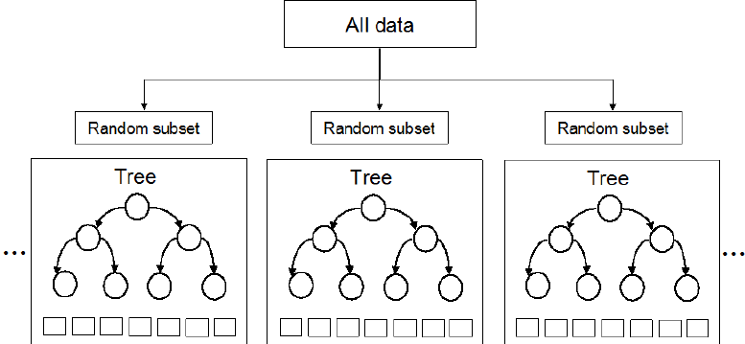
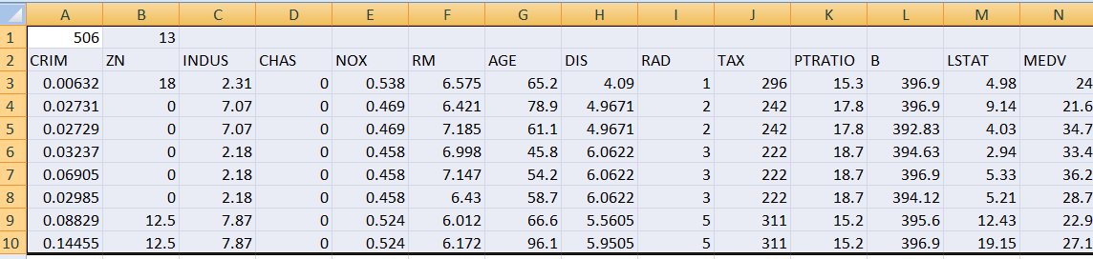
RANDOM FOREST

Slide 26
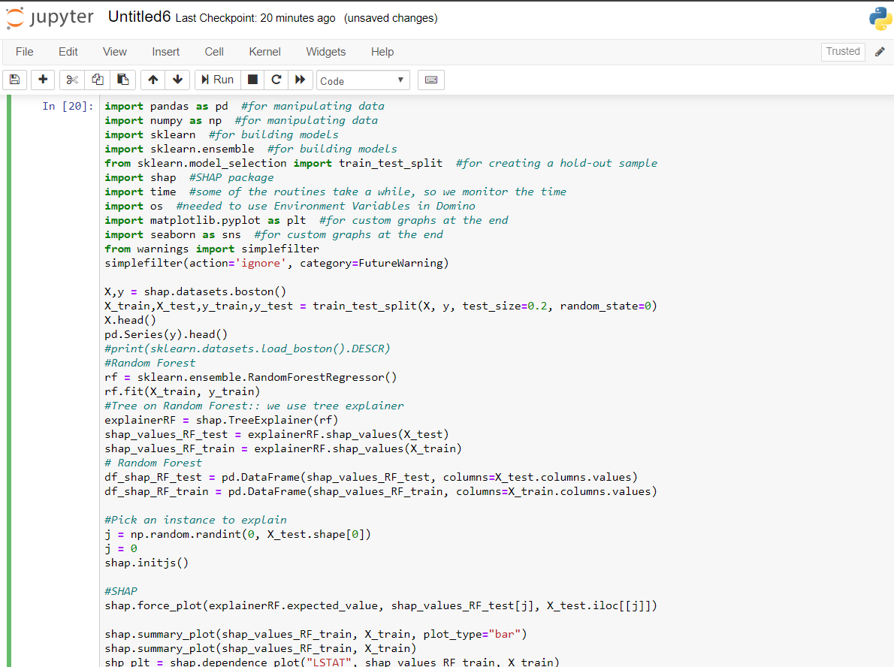
Code Snippet

Slide 27
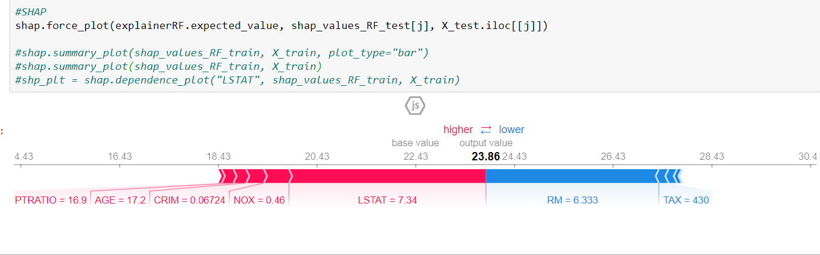
OUTPUT:

Slide 28
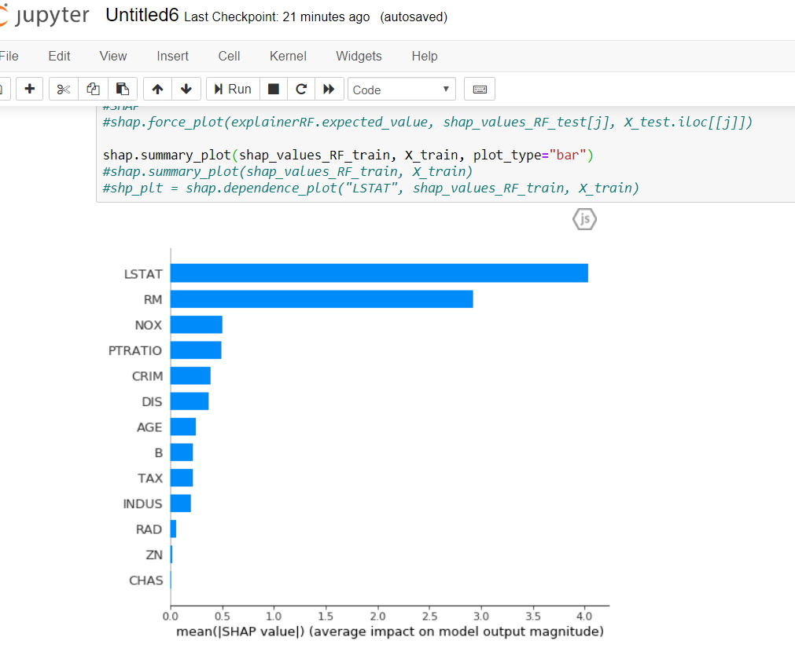
Shap summary plot with all the features:

Slide 29
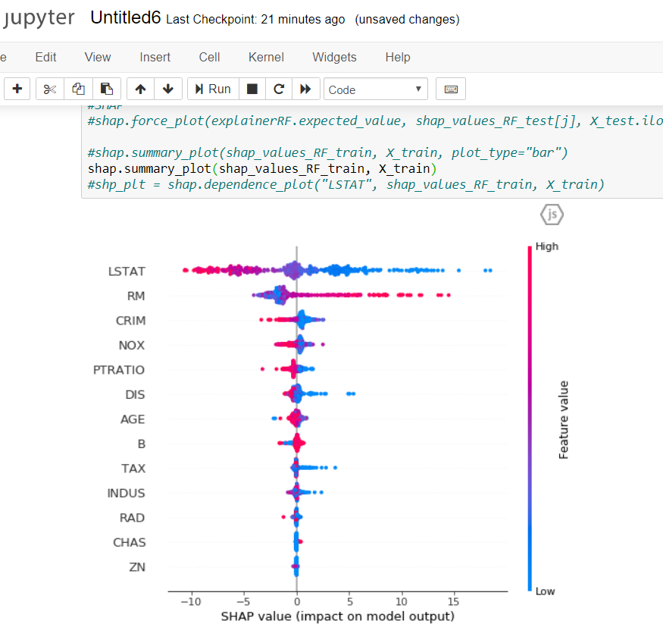
SHAP SUMMARY PLOT Vs TRAIN SET

Slide 30
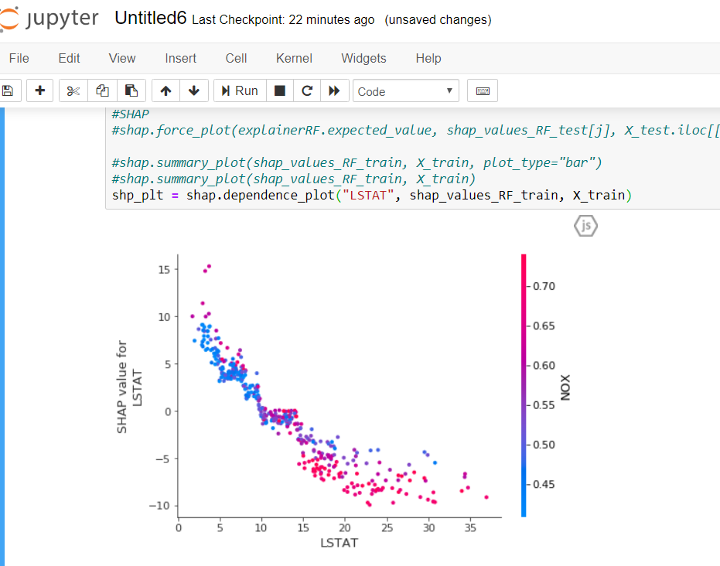
Shap Dependence Plot for LSTAT

Slide 31
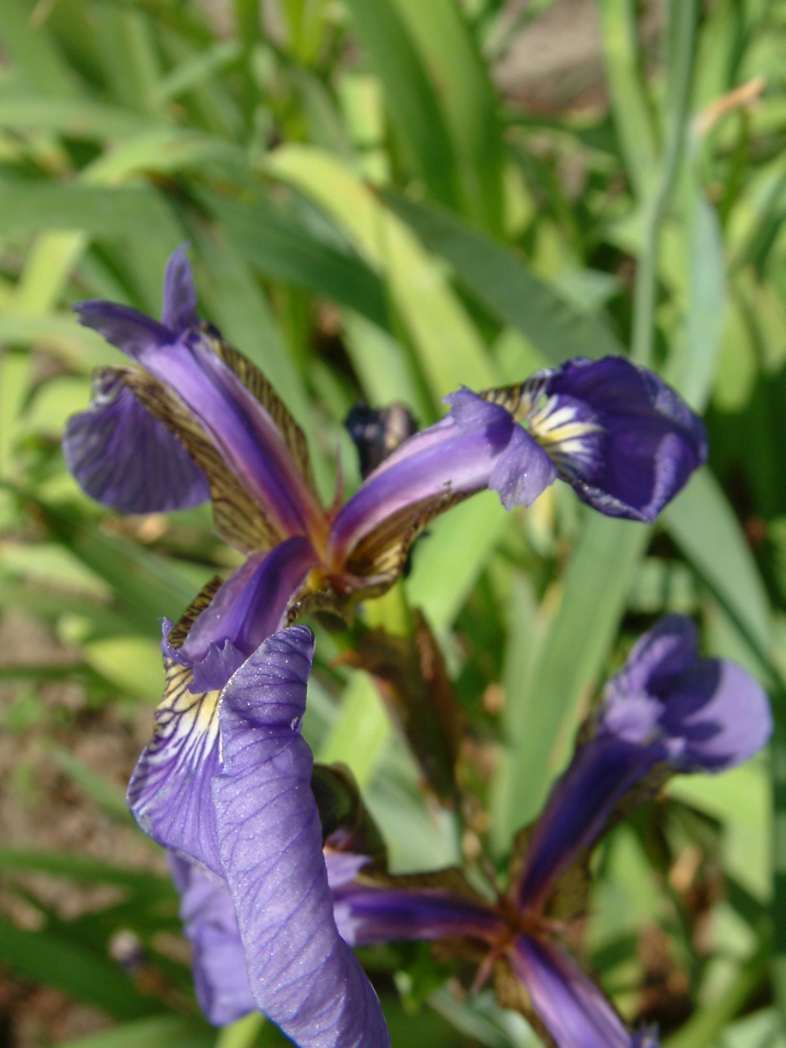
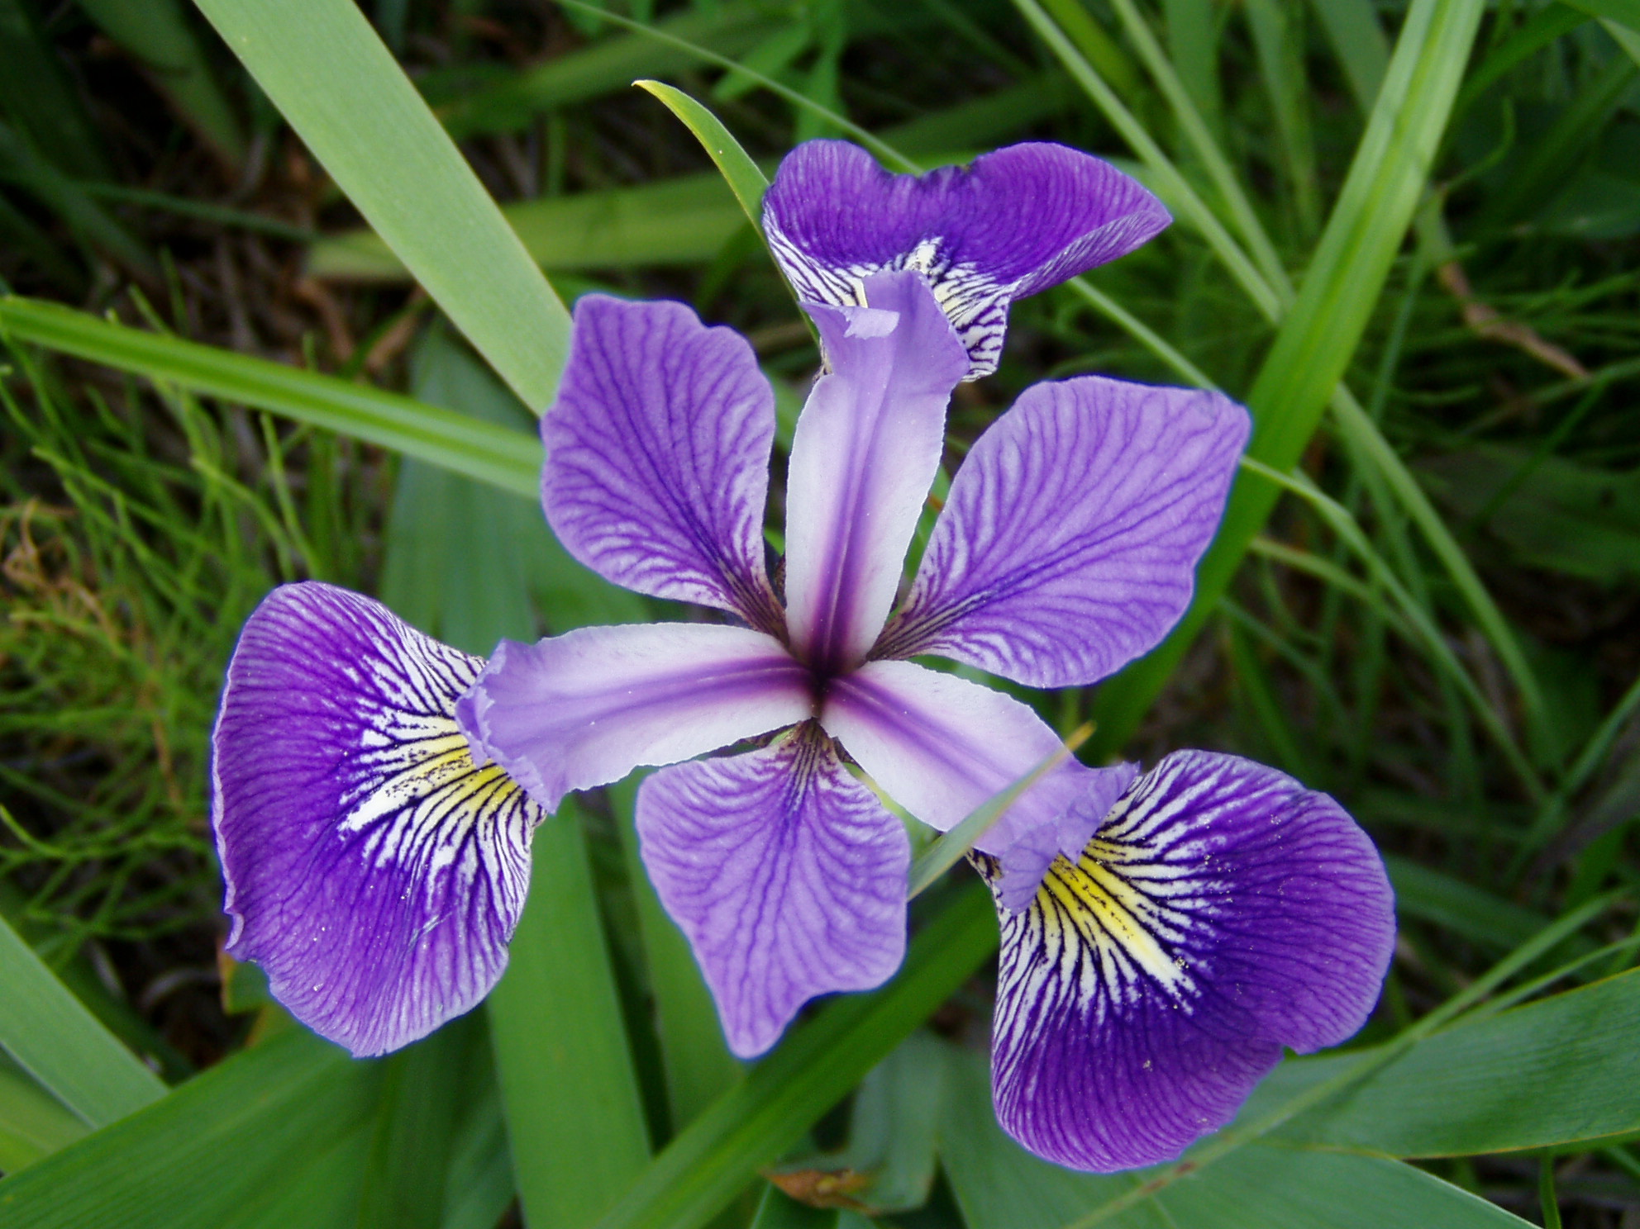
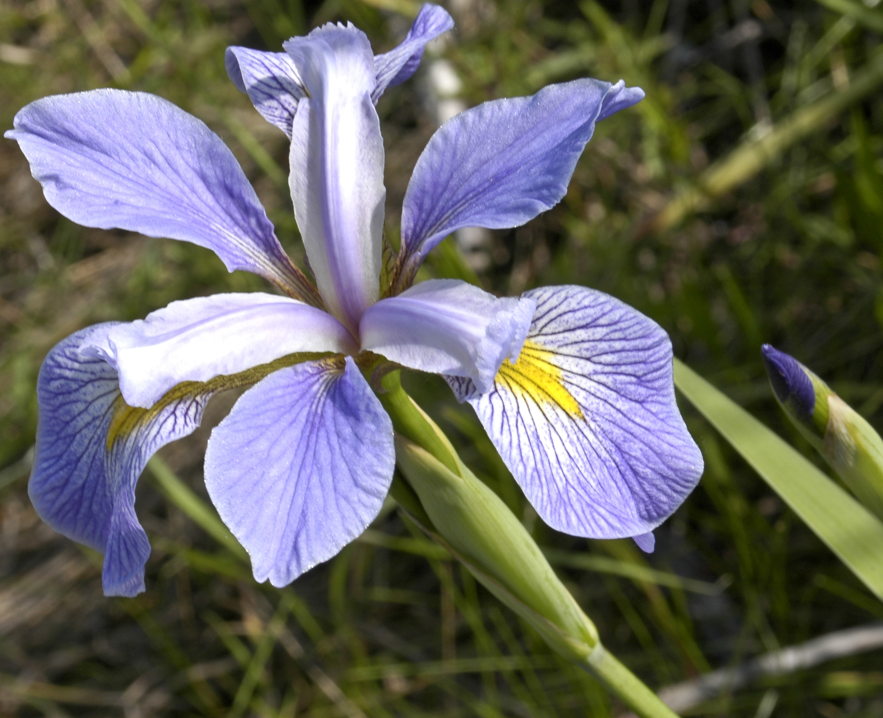
Iris Classification Using Logistic Regression
Every element of Dataset belongs to one of the three classes:
Iris Setosa
Iris Versicolor
Iris Virginica

Slide 32
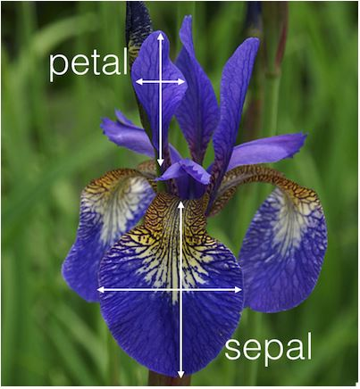
Features used in this classification:
Sepal Length (in cm)
Sepal Width (in cm)
Petal Length (in cm)
Petal Width (in cm)
Dataset for this model has been taken from iris.csv file of sklearn module

Slide 33
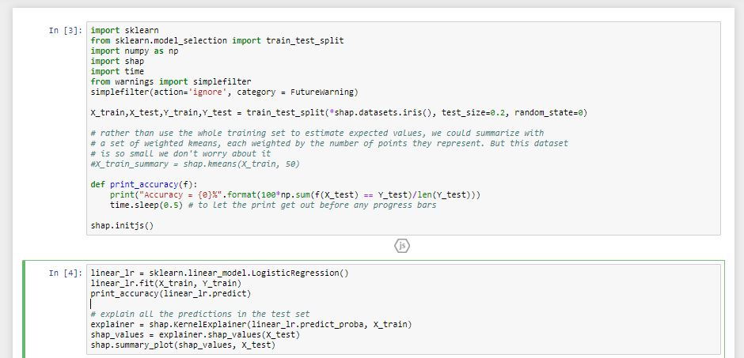
Code Snippet

Slide 34
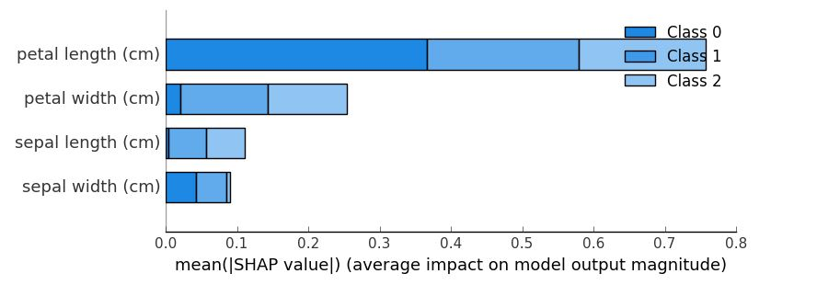
Model Explainability using SHAP

Slide 35
SHAP ON IMAGE CLASSIFICATION

Slide 36
IMAGE CLASSIFICATION
Explain predictions of the model on four images.
Every element of Dataset belongs to one of the nine digits(0-9).
Integrating SHAP to this model.
The plot explains ten outputs (digits 0-9) for four different images.

Slide 37
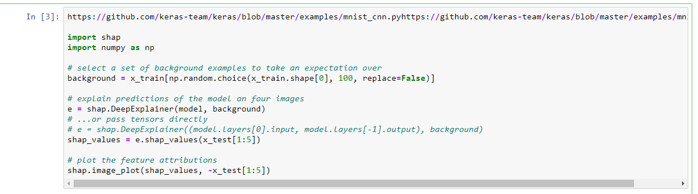
Code Snippet

Slide 38
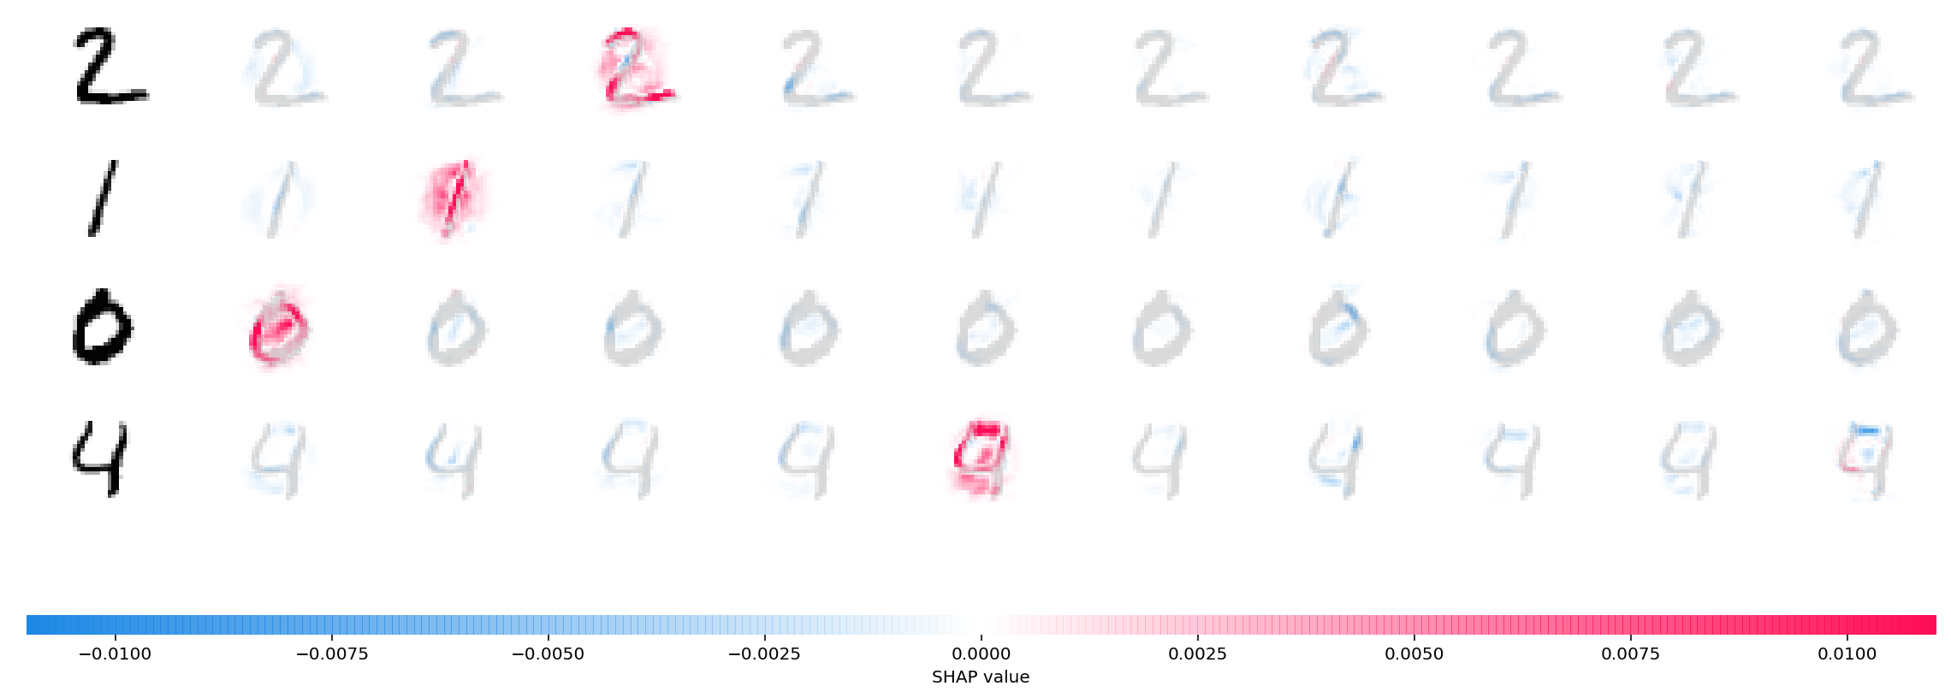

Slide 39
Model Explainability using SHAP
The plot above explains ten outputs (digits 0-9) for four different images.
Red pixels increase the model's output while blue pixels decrease the output.
The input images are shown on the left, and as nearly transparent grayscale backings behind each of the explanations.
Note that for the 'zero' image the blank middle is important, while for the 'four' image the lack of a connection on top makes it a four instead of a nine.

Slide 40
WHAT’S NEXT?
Speech classification using deep learning:
Majorly classifying into three types
Interrogative(?)
Exclamatory(!)
Declarative(.)

Slide 41
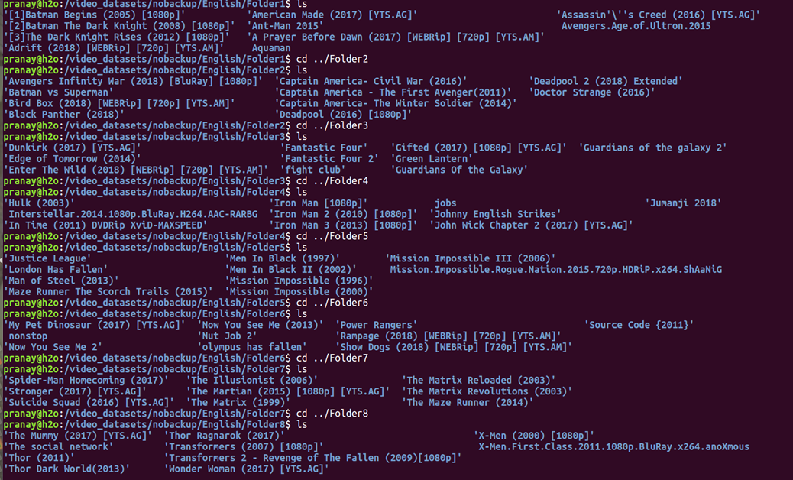
Data set

Slide 42
EXPLAINABLE AI
PROJECT TEAM
Pranay Bunari BT16CSE014
G. Sathish Reddy BT16CSE024
G. Sai Karthik BT16CSE025
Eshwar Koride BT16CSE042
UNDER THE GUIDANCE OF
Dr. Dipti Shrimankar

Slide 43
WHAT WE DID?
AUG
SEP
OCT
NOV
Study and re-search about SHAP and LIME
Data set preparation &input order.
Conversion of mp3 to wav and then into numpy arrays and input order
Project & Team Finalization
SHAP implementations on linear regression , logistic regression and random forests.

Slide 44
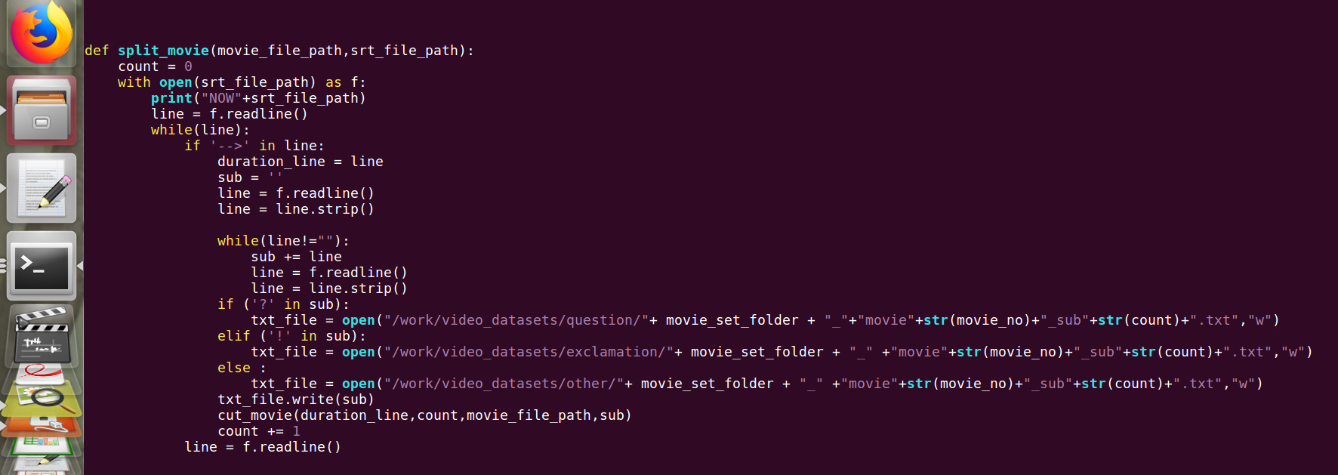
DATA INPUT
(Split movie)

Slide 45
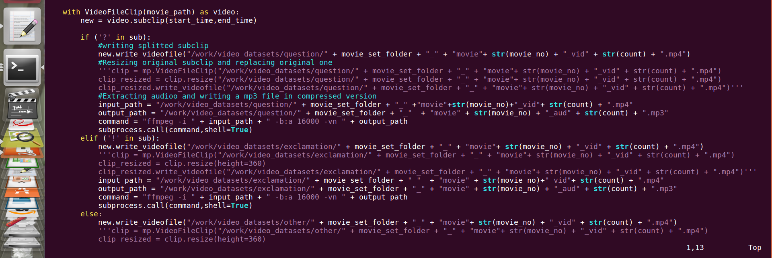
(Cut movie)

Slide 46
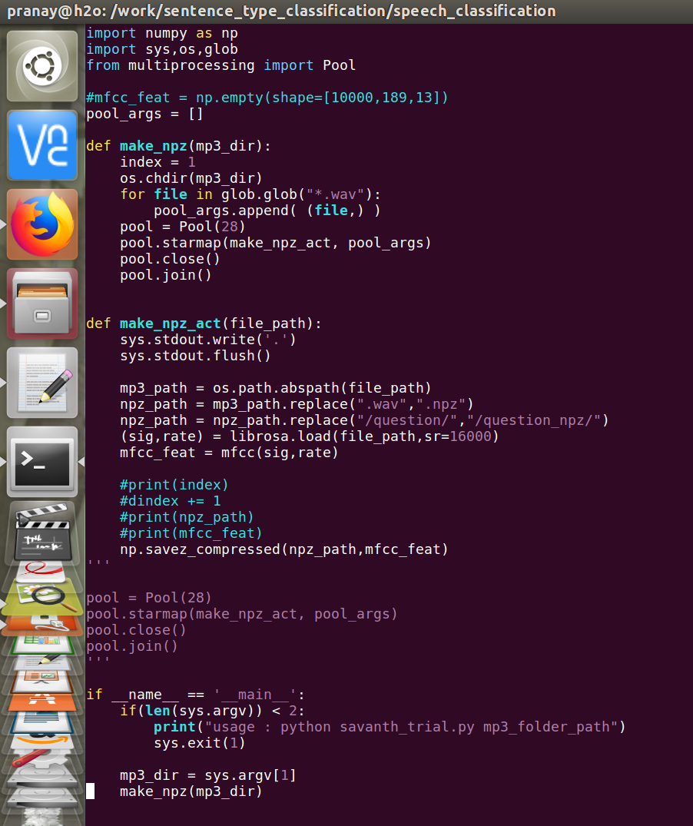
DATA CONVERSION Initially we need to convert .mp3 to .wav using librosa. .sr = 16000 & this code shows conversion of .wav to npz using pool.

Slide 47
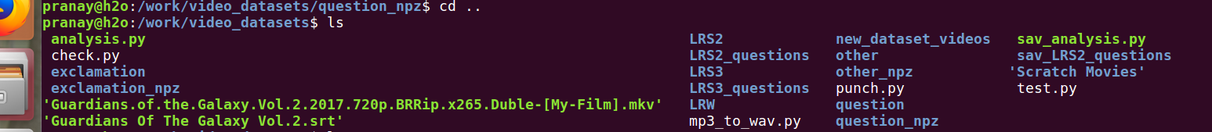
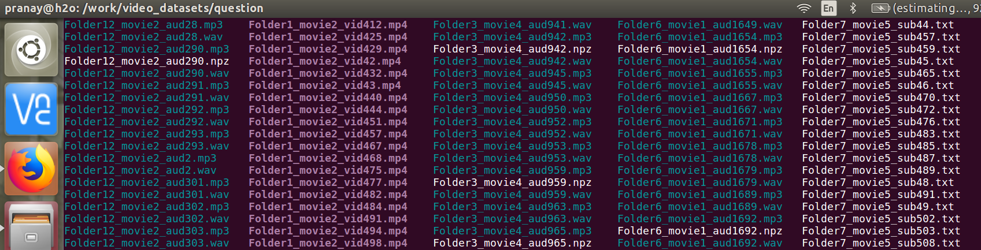
OUTPUT:

Slide 48
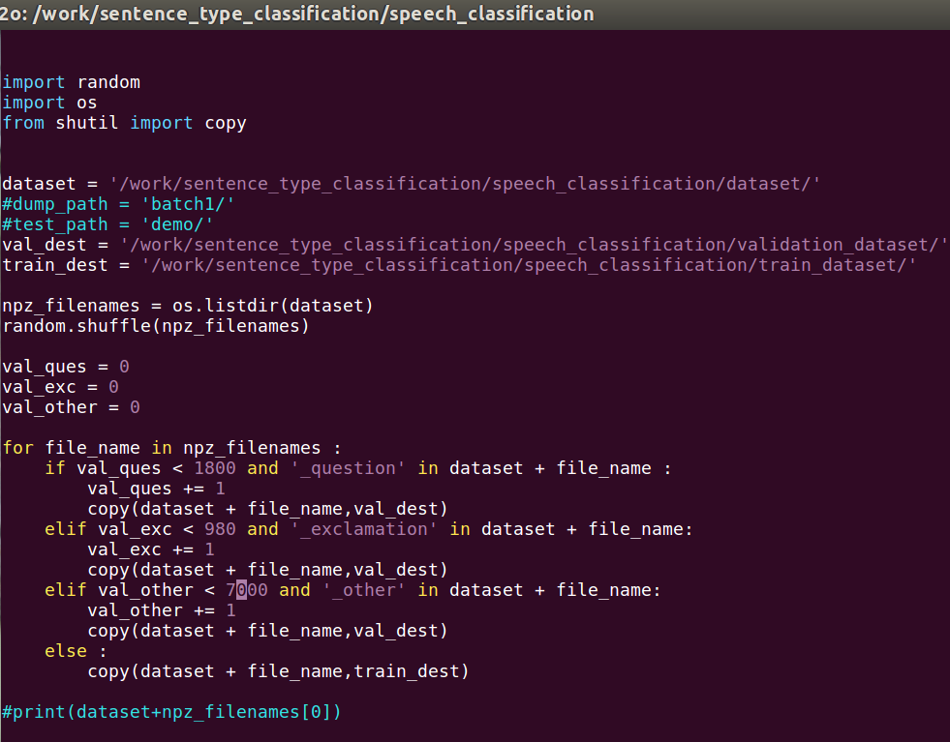
Given directory containing all .npz files it splits them to train and validation folders. Wherein validation contains 10% of total data.

Slide 49
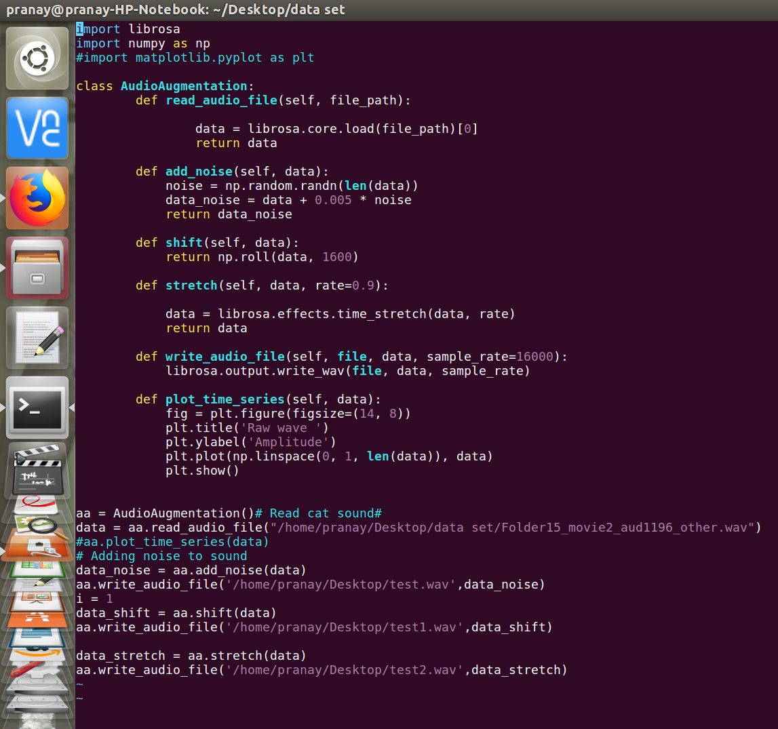
DATA AUGUMENTATION For better accuracy we make some changes to data like adding noise, stretching and compression.

Slide 50
FLOW:
MOVIE’s with .SRT
.MP4, .MP3, .TXT
LIBROSA
.WAV
INPUT TO THE MODEL
pool
.NPZ

Slide 51
For implementation using Deep Learning, Let us go through some well known models of Deep Learning.

Slide 52
Project timeline
FEB
MAR
APR
Addition of shap to the model
Final Submission
Come up with a model
Deciding the model such that to maintain a better accuracy
Will be finding how the features effecting the output and why
Final changes and submission.

Slide 53
references
https://blog.dominodatalab.com/shap-lime-python-libraries-part-1-great-explainers-pros-cons/
https://blog.dominodatalab.com/shap-lime-python-libraries-part-2-using-shap-lime/
https://arxiv.org/abs/1705.07874
https://github.com/slundberg/shap

Slide 54
Thank you!

Slide 55
EXPLAINABLE AI
PROJECT TEAM
Pranay Bunari BT16CSE014
G. Sathish Reddy BT16CSE024
G. Sai Karthik BT16CSE025
Eshwar Koride BT16CSE042
UNDER THE GUIDANCE OF
Dr. Dipti Shrimankar
Saurabh Jain(Persistent Systems)
Hemanth kshirsagar(Persistent Systems)

Slide 56
AGENDA:
What we did?
Real life problem
ML Flow
Input data processing
What’s Next?

Slide 57
WHAT WE DID?
SEP
OCT
DEC
JAN
SHAP implementations on linear regression , logistic regression and random forests.
Splitting of moviesdata &
Conversion of mp3 to wav and then into npz arrays
Project & Team Finalization
Study and re-search about SHAP and LIME
Study and research about speech classification
&
Data set preparation

Slide 58
Speech Classification
Take a real life model and implement Shap to it.
Majorly classifying into three types
Interrogative(?)
Exclamatory(!)
Assertive(.)
Model to be implemented – RNN model.
Around 90plus movies along with their .srt files is taken as input.

Slide 59
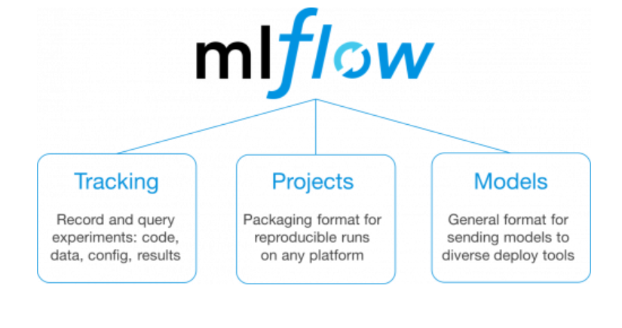
ML FLOW

Slide 60
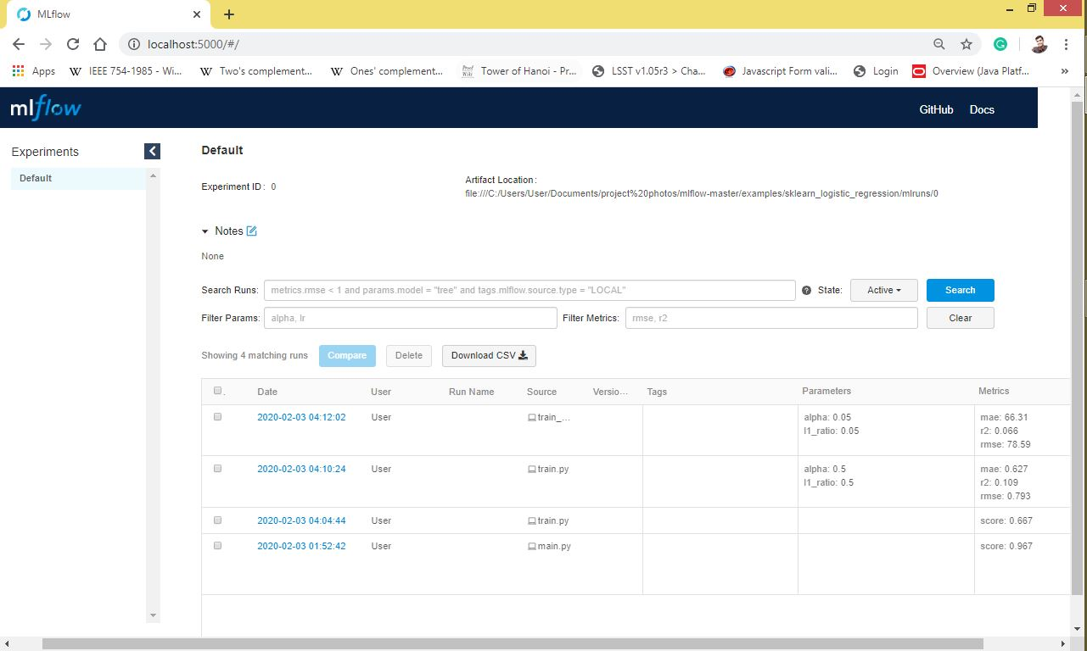
ML FLOW

Slide 61
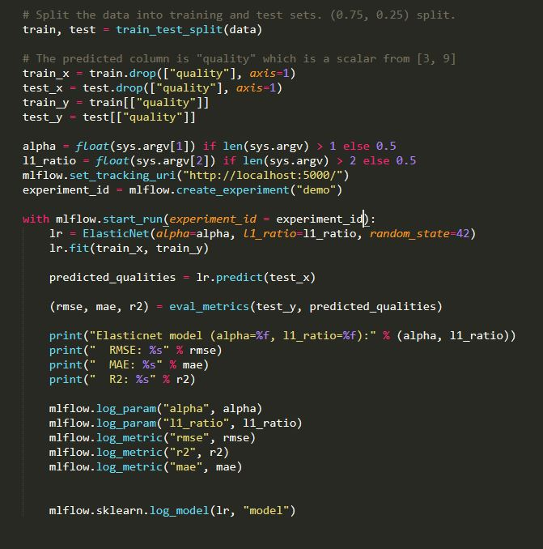
MLFLOW

Slide 62
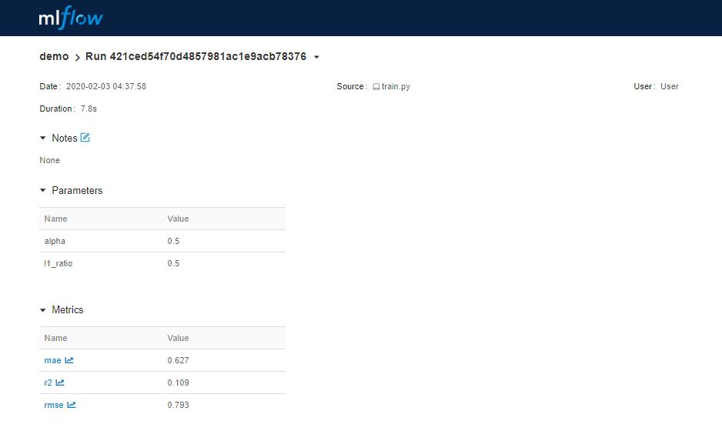
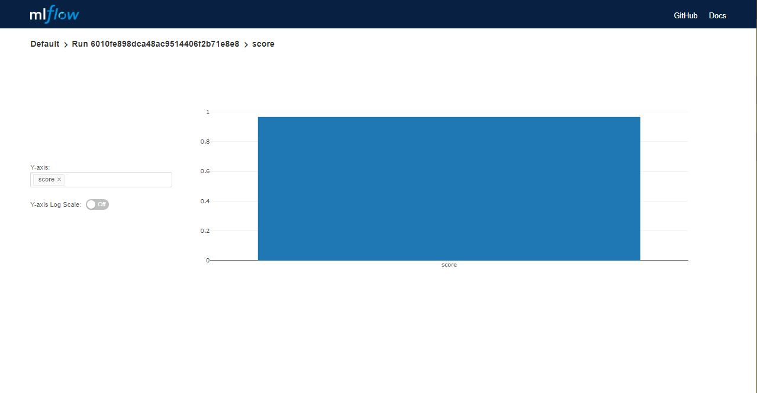
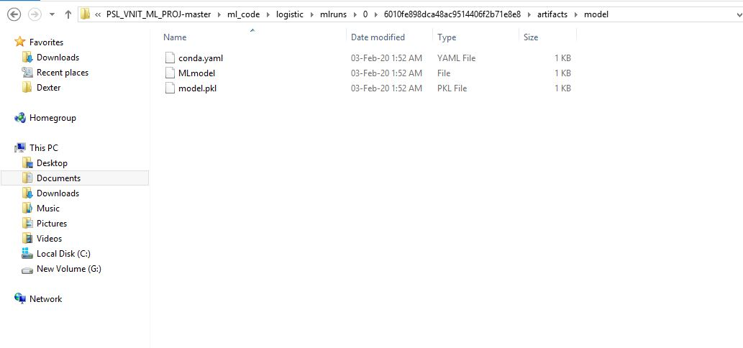

Slide 63
FLOW:
MOVIE’s with .SRT
.MP4, .MP3, .TXT
LIBROSA
.WAV
INPUT TO THE MODEL
mfcc
.NPZ

Slide 64
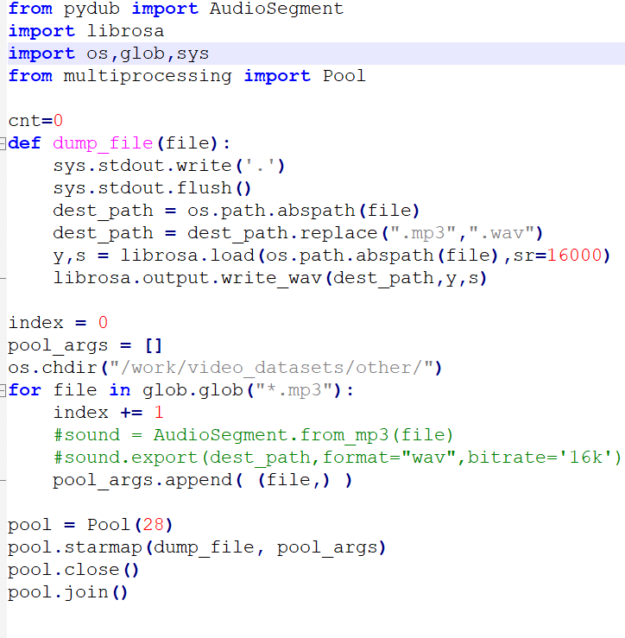
This is how we are converting .mp3 to .wav using librosa

Slide 65
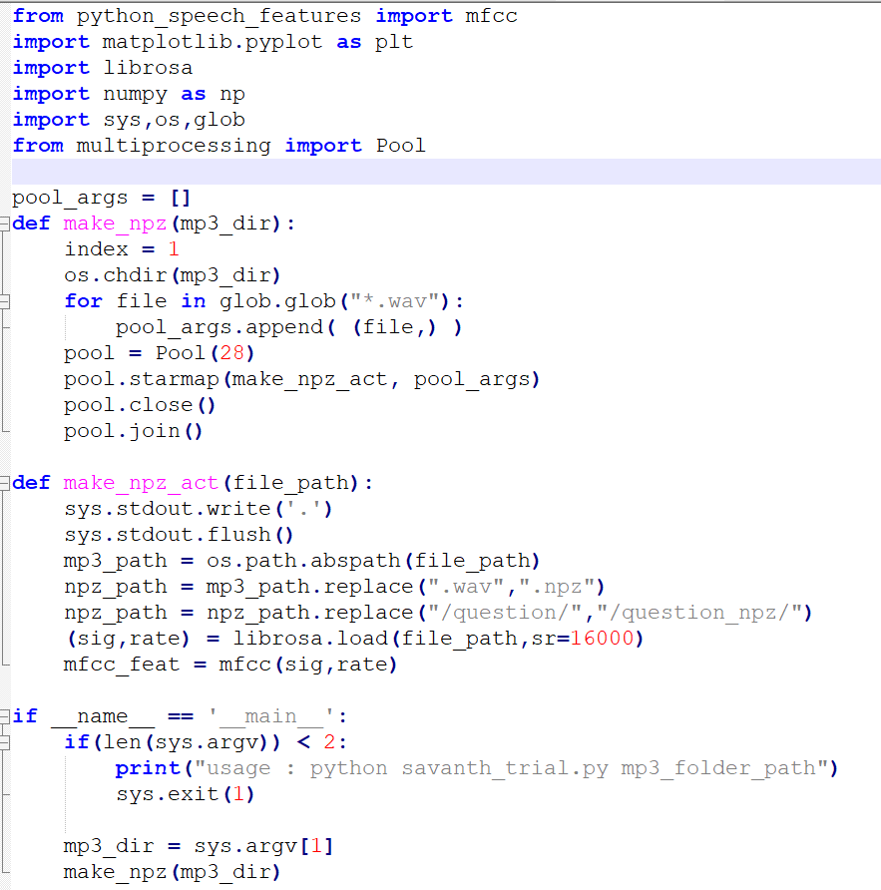
Conversion of .wav to .npz arrays

Slide 66
WHAT’S NEXT?
MAR
APR
MAY
SHAP implementations on RNN and final changes
RNN model and its accuracy
Pipeline using MLFLOW

Slide 67
references
https://blog.dominodatalab.com/shap-lime-python-libraries-part-1-great-explainers-pros-cons/
https://blog.dominodatalab.com/shap-lime-python-libraries-part-2-using-shap-lime/
https://arxiv.org/abs/1705.07874
https://github.com/slundberg/shap
https://towardsdatascience.com/getting-started-with-mlflow-52eff8c09c61
https://mlflow.org/docs/latest/projects.html
https://www.tensorflow.org/api_docs/python/tf/keras/layers/RNN

Slide 68
Thank you!

